Slide 1

Resampling Techniques for Univariate and Multivariate Analyses in R
Derek Beaton

Slide 2
Background
Virtually all statistical inference based on distributions
Many well defined distributions (e.g., F, t)
Usually: Statistic & DoF → look up p-value
Probability of where effect lives in distribution
Notes:
Frequentists

Slide 3
Background
Null hypothesis significance testing & p
“the probability of getting results at least as extreme as the ones you observed, given that the null hypothesis is correct”
No one really knows what that means
http://fivethirtyeight.com/features/not-even-scientists-can-easily-explain-p-values/
http://www.fharrell.com/2017/01/null-hypothesis-significance-testing.html
Notes:
Maybe Fisher knew. That’s why we do what we do – he hated Bayesianists that deeply.

Slide 4
Background
Null hypothesis significance testing & p
"the degree to which the data are embarrassed by the null hypothesis.”
No one really knows what that means
http://fivethirtyeight.com/features/not-even-scientists-can-easily-explain-p-values/
http://www.fharrell.com/2017/01/null-hypothesis-significance-testing.html
Notes:
Maybe Fisher knew. That’s why we do what we do – he hated Bayesianists that deeply.

Slide 5
Background
Many problems here
Root:
NHST, p-values = hard to understand
Response:
Bayesian or prediction approaches
Notes:
As if we didn’t already know;
The real root is lack of exposure and training to all things stats.

Slide 6
Background
What if
We don’t fit assumptions?
We don’t know or have distributions?

Slide 7
One sure thing
The data don’t lie

Slide 8
Outline
What is resampling?
Permutation
Bootstrap
Split-half
Conclusions

Slide 9
Outline
What is resampling?
Permutation
Bootstrap
Split-half
Conclusions

Slide 10
What is Resampling?
What is resampling
Use data to build distributions
Wide array of approaches
Today: permutation, bootstrap, split-half
Jackknife & cross validation
To a different extent: Monte Carlo

Slide 11
What is Resampling?
Wide array of methods to
Estimate change of statistics (e.g., F, r)
Or “variables” (e.g., components, factors)
Estimate validity, reliability, and stability of statistics or models

Slide 12
What is Resampling?
Thought of as modern
In practice
1940s – Quenouille (foundation of jackknife)
1940s – Ulam & von Neumann (Monte Carlo)
Late 1950s – Tukey (establish jackknife)
Late 1970s-1980s – Efron (extend jackknife to bootstrap)
But…
Fisher and Student did this long ago
Fisher painfully created (literally) the distributions we use today

Slide 13
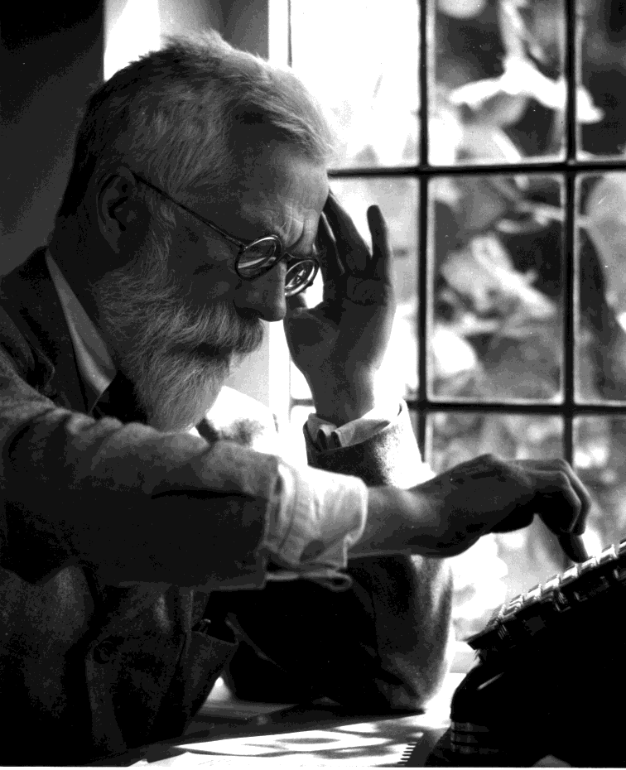
Fisher Permuted

Slide 14
A bit of history

Slide 15
A bit of history
Fisher was brilliant but mean
Notes:
We can credit and blame him. He also is responsible for a deep hatred and distrust of Bayesian approaches, which we are now just getting over.

Slide 16
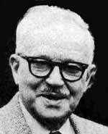
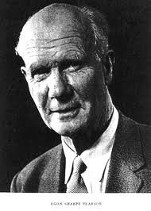
A bit of history
Fisher hated Neyman & E. Pearson

Slide 17
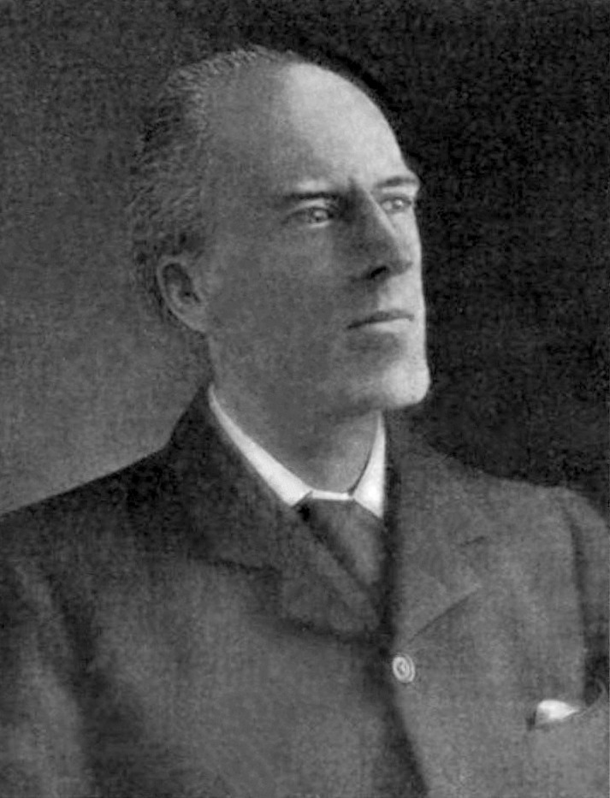
A bit of history
Because Fisher hated K. Pearson
Notes:
In part. A bitter rivalry over particulars of methods, especially chi-square tests.

Slide 18
A bit of history
vs.
Notes:
This rivalry and Fisher’s approach cemented what we do. There were many philosophical, mathematical, and statistical differences in the approaches and even specific tests proposed by all of these people.
But they had one mutual friend

Slide 19
A bit of history
Notes:
This rivalry and Fisher’s approach cemented what we do. There were many philosophical, mathematical, and statistical differences in the approaches and even specific tests proposed by all of these people.
But they had one mutual friend

Slide 20
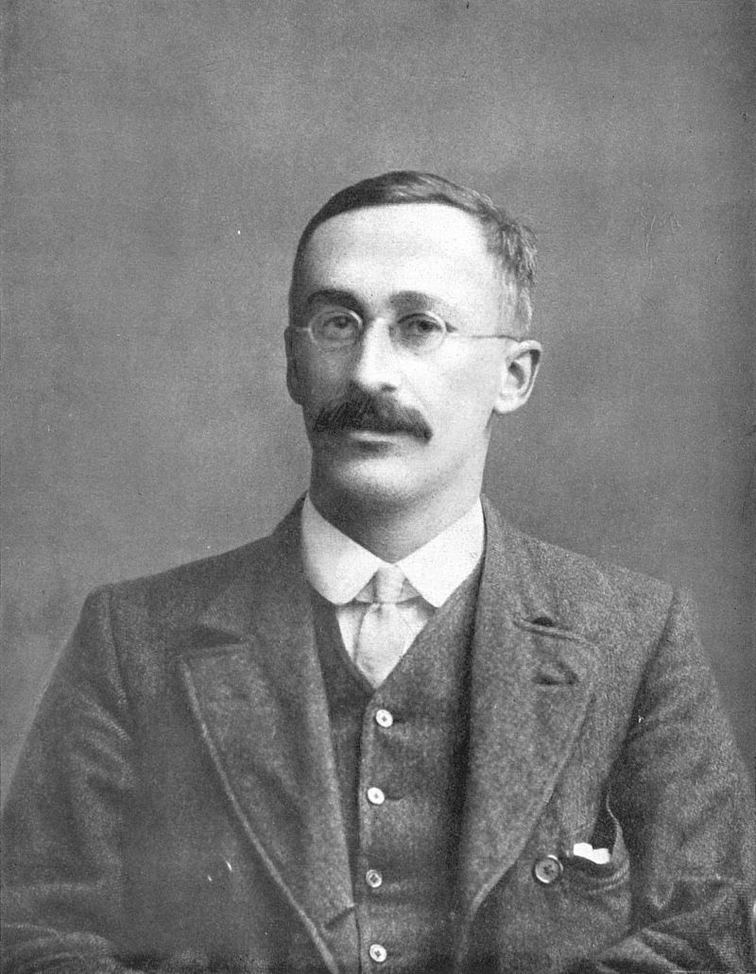
A bit of history
Notes:
Anyone know who this is?

Slide 21
A bit of history
William S. Gosset
The S does not stand for Student
Friend of Fisher & K. Pearson

Slide 22
A bit of history
Student
Resampled small samples
Gave to Fisher
Fisher extended Student’s work
Prohibited from giving away secrets
Of Guinness Brewing

Slide 23
Thus
If Student used beer to understand statistics
We will too!
Notes:
A very round about way to get to this point!

Slide 24
Data
47 Beers available at LCBO
Style, ratings, price, region, etc…
Only subsets for today
github.com/derekbeaton/CANvUSA_BeerPrices
Notes:
github.com/derekbeaton/CANvUSA_BeerPrices

Slide 25
Data
Correlation
USA Beer @ LCBO
LCBO vs. Total Wine serving price (CAD)
2 x 2 ANOVA
USA vs. CAN
DV: Ratings; Factors: Region & Style
PCA
Ratings, price, and ABV
github.com/derekbeaton/CANvUSA_BeerPrices
Notes:
github.com/derekbeaton/CANvUSA_BeerPrices

Slide 26
Why Resampling?
That’s how Student and Fisher did it
That’s how Tukey did it
That’s how Efron does it
If some of the most influential and important minds in statistics do it – we probably should, too
Notes:
Bill Revelle said that if Fisher & Student had computers, this is what they’d be doing.

Slide 27
Outline
What is resampling?
Permutation
Bootstrap
Split-half
Conclusions

Slide 28
Outline
What is resampling?
Permutation
Bootstrap
Split-half
Conclusions

Slide 29
Outline
What is resampling?
Permutation
Bootstrap
Split-half
Conclusions
Correlation
ANOVA
Principal Components Analysis

Slide 30
Outline
What is resampling?
Permutation
Bootstrap
Split-half
Conclusions
Correlation
ANOVA
Principal Components Analysis

Slide 31
Outline
What is resampling?
Permutation
Bootstrap
Split-half
Conclusions
Correlation
ANOVA
Principal Components Analysis

Slide 32
Outline
What is resampling?
Permutation
Bootstrap
Split-half
Conclusions
Correlation (via regression)
ANOVA
Principal Components Analysis

Slide 33
Note
github.com/derekbeaton/Workshops
Today’s slide & code (including ANOVA)
And some additional ANOVA & PCA material

Slide 34
Outline
What is resampling?
Permutation
Bootstrap
Split-half
Conclusions
Correlation
ANOVA
Principal Components Analysis

Slide 35
Permutation
Build a null distribution
Many null experiments vs. observed
An exact test
Break the relationship in the data

Slide 36
Permutation
Obs. | W | Y
Liberty | 2.54 | 2.12
Sam | 2.29 | 1.90
Pale | 2.62 | 1.90
Bam | 4.24 | 8.24
Arrogant | 3.19 | 2.01
Seven | 5.18 | 5.70

Slide 37
Permutation
Obs. | W | Obs. | Y
Liberty | 2.54 | Liberty | 2.12
Sam | 2.29 | Sam | 1.90
Pale | 2.62 | Pale | 1.90
Bam | 4.24 | Bam | 8.24
Arrogant | 3.19 | Arrogant | 2.01
Seven | 5.18 | Seven | 5.70

Slide 38
Permutation
Obs. | W
Liberty | 2.54
Sam | 2.29
Pale | 2.62
Bam | 4.24
Arrogant | 3.19
Seven | 5.18
Obs. | Y
Liberty | 2.12
Sam | 1.90
Pale | 1.90
Bam | 8.24
Arrogant | 2.01
Seven | 5.70

Slide 39
Permutation
Obs. | W
Liberty | 2.54
Sam | 2.29
Pale | 2.62
Bam | 4.24
Arrogant | 3.19
Seven | 5.18
Obs. | Y
Pale | 1.90
Bam | 8.24
Arrogant | 2.01
Seven | 5.70
Liberty | 2.12
Sam | 1.90

Slide 40
Permutation
Obs. | W | Obs. | Y
Liberty | 2.54 | Pale | 1.90
Sam | 2.29 | Bam | 8.24
Pale | 2.62 | Arrogant | 2.01
Bam | 4.24 | Seven | 5.70
Arrogant | 3.19 | Liberty | 2.12
Seven | 5.18 | Sam | 1.90

Slide 41
Permutation
“Obs.” | W | Y_{perm}
Liberty | 2.54 | 1.90
Sam | 2.29 | 8.24
Pale | 2.62 | 2.01
Bam | 4.24 | 5.70
Arrogant | 3.19 | 2.12
Seven | 5.18 | 1.90

Slide 42
Permutation
Data
22 American beers
Available at LCBO & Total Wine
Cost converted to per 355 ml serving
What is the correlation?

Slide 43
Permutation

Slide 44
Permutation
Parametric:
r = 0.885
p = 4.534 x 10⁻⁸

Slide 45
Permutation

Slide 46
Permutation
PERMUTE!

Slide 47
Permutation
SAVE!
1 | -0.385
2
3 | …
4 | …
5 | …
… | …
… | …
998 | …
999 | …
1000

Slide 48
Permutation

Slide 49
Permutation
REPEAT!
1 | -0.385
2 | 0.206
3 | …
4 | …
5 | …
… | …
… | …
998 | …
999 | …
1000

Slide 50
Permutation
REPEAT A LOT!
1 | -0.385
2 | 0.206
3 | …
4 | …
5 | …
… | …
… | …
998 | …
999 | …
1000 | 0.453

Slide 51
Permutation
PLOT!
1 | -0.385
2 | 0.206
3 | …
4 | …
5 | …
… | …
… | …
998 | …
999 | …
1000 | 0.453

Slide 52
Permutation
PLOT!
1 | -0.385
2 | 0.206
3 | …
4 | …
5 | …
… | …
… | …
998 | …
999 | …
1000 | 0.453
Notes:
Note the center.

Slide 53
Permutation
p = .000?

Slide 54
Permutation
p is never 0
If you get 0: it is < the number of iterations
We did 1,000

Slide 55
Permutation
p < .001

Slide 56
Permutation
p < .001

Slide 57
Permutation
p < .001

Slide 58
Permutation
Quiz: Which is better?
p_{perm} < 0.001
p = .0000000453

Slide 59
Permutation
Quiz: Which is better?
p_{perm} < 0.001
p = .0000000453

Slide 60
Permutation
Quiz: Which is better?
p_{perm} < 0.001
p = .0000000453

Slide 61
Permutation
Iterations: 22,057,646
p_{perm} = 0.00000131
vs
p = .0000000453

Slide 62
Permutation
Iterations: 22,057,646
-log₁₀ (p_{perm}) = -5.882
vs
-log₁₀ (p) = -7.343

Slide 63
Permutation
This is why it is called exact
When close to assumptions it gives the sampling distribution null
Our case is a touch skewed
More - than + (around 0)
Min: -.6; Max = .9

Slide 64
Outline
What is resampling?
Permutation
Bootstrap
Split-half
Conclusions
Correlation
ANOVA
Principal Components Analysis

Slide 65
Permutation
Data
39 American & Canadian Beers at LCBO
Pale ale style vs. not pale ale
Ratings within style
2 x 2 ANOVA

Slide 66
Permutation
Obs. | Re | S | Ra
Liberty | USA | PALE | 95
Sam | USA | NOT | 44
Pale | USA | PALE | 97
Robohop | CAN | PALE | 47
Pilsner | CAN | NOT | 93
Dupump | CAN | NOT | 70

Slide 67
Permutation
Obs. | Re | S | Ra
Liberty | USA | PALE | 95
Sam | USA | NOT | 44
Pale | USA | PALE | 97
Robohop | CAN | PALE | 47
Pilsner | CAN | NOT | 93
Dupump | CAN | NOT | 70

Slide 68
Permutation
Obs. | Re | S | Ra
Liberty | USA | PALE | 44
Sam | USA | NOT | 70
Pale | USA | PALE | 95
Robohop | CAN | PALE | 93
Pilsner | CAN | NOT | 97
Dupump | CAN | NOT | 47

Slide 69
Permutation

Slide 70
Permutation
Parametric:
REGION:
F(1,35) = 22.55
p = 3.408 x 10⁻⁵
STYLE:
F(1,35) = 28.37
p = 5.957 x 10⁻⁶
RxS:
F(1,35) = 24.26
p = 2.003 x 10⁻⁵

Slide 71
Permutation

Slide 72
Permutation
1 | 1.55 | 0.02 | .34
2 | 0.01 | 0.45 | 0.83
3 | … | … | …
4 | … | … | …
5 | … | … | …
… | … | … | …
… | … | … | …
998 | … | … | …
999 | … | … | …
1000 | 3.42 | 1.60 | 0.75

Slide 73
Permutation

Slide 74
Why ‘ez’?
R thinks about unbalanced ANOVAs one way
Everything else thinks about them another
‘ez’ package is easy
Allows for easy Type III sums of squares
Friendly input & output

Slide 75
Why ‘ez’?
R thinks about unbalanced ANOVAs one way
Everything else thinks about them another
‘ez’ package is easy
Allows for easy Type III sums of squares
Friendly input & output

Slide 76
Permutation
Permutation (1000):
REGION:
F(1,35) = 22.55
p_{perm} < .001
STYLE:
F(1,35) = 28.37
p_{perm} < .001
RxS:
F(1,35) = 24.26
p_{perm} < .001

Slide 77
Permutation
Permutation (1000):
REGION:
F(1,35) = 22.55
p_{perm} < .001
STYLE:
F(1,35) = 28.37
p_{perm} < .001
RxS:
F(1,35) = 24.26
p_{perm} < .001

Slide 78
Permutation
Permutation (1000):
REGION:
F(1,35) = 22.55
p_{perm} < .001
STYLE:
F(1,35) = 28.37
p_{perm} < .001
RxS:
F(1,35) = 24.26
p_{perm} < .001

Slide 79
Permutation
Permutation (1000):
REGION:
F(1,35) = 22.55
p_{perm} < .001
STYLE:
F(1,35) = 28.37
p_{perm} < .001
RxS:
F(1,35) = 24.26
p_{perm} < .001

Slide 80
Permutation
Permutation (167,862):
REGION:
F(1,35) = 22.55
p_{perm} = .000161
STYLE:
F(1,35) = 28.37
p_{perm} = .000065
RxS:
F(1,35) = 24.26
p_{perm} = .000285

Slide 81
Permutation
Parametric:
REGION:
F(1,35) = 22.55
p = .000034
STYLE:
F(1,35) = 28.37
p = .000005
RxS:
F(1,35) = 24.26
p = .000020

Slide 82
Permutation
A (strong) word of caution
Permutation tests are not conservative
They are exact
You must correct for multiple comparisons

Slide 83
Different beer different data
Fictitious
International brewing conference
Factor: CAN vs. USA
Factor: Professional vs. Homebrewer
DV: Aggregate judges ratings

Slide 84
Permuted: 100k

Slide 85
Permuted: 100k

Slide 86
Permutation
A (strong) word of caution
Permutation tests are not conservative
They are exact
You must correct for multiple comparisons

Slide 87
Permutation
“This is why permutations result in conservative p-values. For this reason, when we have few samples, we can’t do permutations.”
A Genomics Textbook on Github
Subtle: Nichols & Holmes (2001). Nonparametric Permutation Tests for Functional Neuroimaging: A Primer with Examples. HBM. 15:1-25. Wiley.
Notes:
There are two incorrect statemnts here.

Slide 88
Outline
What is resampling?
Permutation
Bootstrap
Split-half
Conclusions
Correlation
ANOVA
Principal Components Analysis

Slide 89
PCA
Obs. | W | Y
Liberty | 2.54 | 2.12
Sam | 2.29 | 1.90
Pale | 2.62 | 1.90
Bam | 4.24 | 8.24
Arrogant | 3.19 | 2.01
Seven | 5.18 | 5.70
Obs. | Re | S | Ra
Liberty | 2.54 | 5.9 | 95
Sam | 2.29 | 5.0 | 44
Pale | 2.62 | 5.6 | 97
Bam | 4.24 | 5.0 | 94
Arrogant | 3.19 | 7.2 | 98
Seven | 5.18 | 6.9 | 100

Slide 90
PCA
Multivariate technique
Transform data into slices (components)
orthogonal
rank-ordered by variance
Components are new variables
Made up of the original ones

Slide 91
PCA

Slide 92
PCA

Slide 93
PCA

Slide 94
PCA

Slide 95
Permutation
For PCA: Which components to keep?

Slide 96
Permutation
Obs. | W | Y
Liberty | 2.54 | 2.12
Sam | 2.29 | 1.90
Pale | 2.62 | 1.90
Bam | 4.24 | 8.24
Arrogant | 3.19 | 2.01
Seven | 5.18 | 5.70
Obs. | Re | S | Ra
Liberty | 2.54 | 5.9 | 95
Sam | 2.29 | 5.0 | 44
Pale | 2.62 | 5.6 | 97
Bam | 4.24 | 5.0 | 94
Arrogant | 3.19 | 7.2 | 98
Seven | 5.18 | 6.9 | 100

Slide 97
Permutation
Obs. | W | Y
Liberty | 2.54 | 2.12
Sam | 2.29 | 1.90
Pale | 2.62 | 1.90
Bam | 4.24 | 8.24
Arrogant | 3.19 | 2.01
Seven | 5.18 | 5.70
Obs. | Re | S | Ra
Liberty | 2.62 | 7.2 | 95
Sam | 2.54 | 5 | 97
Pale | 2.29 | 5.6 | 100
Bam | 3.19 | 5.9 | 98
Arrogant | 5.18 | 5.0 | 44
Seven | 4.24 | 6.9 | 94

Slide 98
Permutation
Obs. | W | Y
Liberty | 2.54 | 2.12
Sam | 2.29 | 1.90
Pale | 2.62 | 1.90
Bam | 4.24 | 8.24
Arrogant | 3.19 | 2.01
Seven | 5.18 | 5.70
Obs. | Re | S | Ra
Liberty | 2.62 | 7.2 | 95
Sam | 2.54 | 5 | 97
Pale | 2.29 | 5.6 | 100
Bam | 3.19 | 5.9 | 98
Arrogant | 5.18 | 5.0 | 44
Seven | 4.24 | 6.9 | 94

Slide 99
Permutation
Obs. | W | Y
Liberty | 2.54 | 2.12
Sam | 2.29 | 1.90
Pale | 2.62 | 1.90
Bam | 4.24 | 8.24
Arrogant | 3.19 | 2.01
Seven | 5.18 | 5.70
Obs. | Re | S | Ra
Liberty | 2.62 | 7.2 | 95
Sam | 2.54 | 5 | 97
Pale | 2.29 | 5.6 | 100
Bam | 3.19 | 5.9 | 98
Arrogant | 5.18 | 5.0 | 44
Seven | 4.24 | 6.9 | 94

Slide 100
Permutation
Obs. | W | Y
Liberty | 2.54 | 2.12
Sam | 2.29 | 1.90
Pale | 2.62 | 1.90
Bam | 4.24 | 8.24
Arrogant | 3.19 | 2.01
Seven | 5.18 | 5.70
Obs. | Re | S | Ra
Liberty | 2.62 | 7.2 | 95
Sam | 2.54 | 5 | 97
Pale | 2.29 | 5.6 | 100
Bam | 3.19 | 5.9 | 98
Arrogant | 5.18 | 5.0 | 44
Seven | 4.24 | 6.9 | 94

Slide 101
Permutation
For PCA

Slide 102
PCA

Slide 103
PCA

Slide 104
PCA

Slide 105
Permutation
For PCA: Which components to keep?
i.e., which explain more variance than null?

Slide 106
PCA

Slide 107
PCA

Slide 108
PCA

Slide 109
PCA

Slide 110
PCA
Permutation (1000):
p_{perm} = .024 p_{perm} = .136 p_{perm} = .997

Slide 111
Permutation
For PCA:
We have one component (source of signal)
Just interpret that one

Slide 112
PCA

Slide 113
PCA

Slide 114
Permutation Recap
Now intuitive:
“the probability of getting results at least as extreme as the ones you observed, given that the null hypothesis is correct”
Count how often your effect is bigger
Build null distributions
Exact null hypothesis test

Slide 115
Outline
What is resampling?
Permutation
Bootstrap
Split-half
Conclusions
Correlation
ANOVA
Principal Components Analysis

Slide 116
Outline
What is resampling?
Permutation
Bootstrap
Split-half
Conclusions
Correlation
ANOVA
Principal Components Analysis

Slide 117
Bootstrap
Resample with replacement
Select observations 0, 1, or many times
Compute statistic
Build distribution
Maintains the relationship in data
Approximate population estimates

Slide 118
Bootstrap
Obs. | W | Y
Liberty | 2.54 | 2.12
Sam | 2.29 | 1.90
Pale | 2.62 | 1.90
Bam | 4.24 | 8.24
Arrogant | 3.19 | 2.01
Seven | 5.18 | 5.70

Slide 119
Bootstrap
Obs. | W | Y
Liberty | 2.54 | 2.12
Sam | 2.29 | 1.90
Pale | 2.62 | 1.90
Bam | 4.24 | 8.24
Arrogant | 3.19 | 2.01
Seven | 5.18 | 5.70

Slide 120
Bootstrap
Obs. | W | Y
Bam | 4.24 | 8.24
Sam | 2.29 | 1.90
Seven | 5.18 | 5.70
Arrogant | 3.19 | 2.01
Sam | 2.29 | 1.90
Bam | 4.24 | 8.24

Slide 121
Bootstrap
Obs. | W | Y
Bam | 4.24 | 8.24
Sam | 2.29 | 1.90
Seven | 5.18 | 5.70
Arrogant | 3.19 | 2.01
Sam | 2.29 | 1.90
Bam | 4.24 | 8.24

Slide 122
Bootstrap
Obs. | W | Y
Bam | 4.24 | 8.24
Sam | 2.29 | 1.90
Seven | 5.18 | 5.70
Arrogant | 3.19 | 2.01
Sam | 2.29 | 1.90
Bam | 4.24 | 8.24

Slide 123
Bootstrap
Obs. | W | Y
Bam | 4.24 | 8.24
Sam | 2.29 | 1.90
Seven | 5.18 | 5.70
Arrogant | 3.19 | 2.01
Sam | 2.29 | 1.90
Bam | 4.24 | 8.24

Slide 124
Bootstrap
Obs. | W | Y
Bam | 4.24 | 8.24
Sam | 2.29 | 1.90
Seven | 5.18 | 5.70
Arrogant | 3.19 | 2.01
Sam | 2.29 | 1.90
Bam | 4.24 | 8.24

Slide 125
Permutation

Slide 126
Permutation
Parametric:
r = 0.885
p = 4.534 x 10⁻⁸

Slide 127
Permutation
BOOTSTRAP!

Slide 128
Permutation
SAVE!
1 | 0.886
2
3 | …
4 | …
5 | …
… | …
… | …
998 | …
999 | …
1000

Slide 129
Permutation

Slide 130
Permutation
REPEAT!
1 | 0.886
2 | 0.939
3 | …
4 | …
5 | …
… | …
… | …
998 | …
999 | …
1000

Slide 131
Permutation
REPEAT A LOT!
1 | 0.886
2 | 0.939
3 | …
4 | …
5 | …
… | …
… | …
998 | …
999 | …
1000 | 0.852

Slide 132
Permutation
PLOT!
1 | 0.886
2 | 0.939
3 | …
4 | …
5 | …
… | …
… | …
998 | …
999 | …
1000 | 0.852

Slide 133
Permutation
PLOT!
1 | 0.886
2 | 0.939
3 | …
4 | …
5 | …
… | …
… | …
998 | …
999 | …
1000 | 0.852
Notes:
Note the center.

Slide 134
Permutation
PLOT!
1 | 0.886
2 | 0.939
3 | …
4 | …
5 | …
… | …
… | …
998 | …
999 | …
1000 | 0.852

Slide 135
Bootstrap
Distribution centered at observed statistic
Approximate population estimates of change
Confidence Intervals: [0.804 < r < 0.982]

Slide 136
How many?
Generally more is better
Try to hit a convergence point
But too many is a waste of time/resources
Efron says: “Enough”
Well, not really – but if data are well behaved 100 is sufficient

Slide 137
Bootstrap
100: [0.800 < r < 0.990]
1,000: [0.804 < r < 0.982]
10,000: [0.805 < r < 0.984]
100,000: [0.803 < r < 0.982]
Parametric: [0.739 < r < 0.952]
Notes:
We can see that the bootstrap is stable even at a small number of resamplings (relative to the total number of observations).

Slide 138
Bootstrap
100: [0.800 < r < 0.990]
1,000: [0.804 < r < 0.982]
10,000: [0.805 < r < 0.984]
100,000: [0.803 < r < 0.982]
Parametric: [0.739 < r < 0.952]

Slide 139
Outline
What is resampling?
Permutation
Bootstrap
Split-half
Conclusions
Correlation
ANOVA
Principal Components Analysis

Slide 140
Outline
What is resampling?
Permutation
Bootstrap
Split-half
Conclusions
Correlation
ANOVA
Principal Components Analysis

Slide 141
PCA

Slide 142
Permutation

Slide 143
Bootstrap
Like permutation: for components
CIs of eigenvalues over bootstraps
Unlike permutation: variable estimates
How much do the variables change?

Slide 144
PCA

Slide 145
Bootstrap
Like permutation: for components
CIs of eigenvalues over bootstraps
Unlike permutation: variable estimates
How much do the variables change?

Slide 146
PCA
δ
0
T
δ
V
0
δ
X
U
=

Slide 147
PCA
δ
0
δ
0
δ
U

Slide 148
PCA

Slide 149
PCA
δ
0
T
δ
V
0
δ

Slide 150
PCA

Slide 151
Bootstrap
X
Variables

Slide 152
Bootstrap
X_{Boot}
X
Variables

Slide 153
Bootstrap
X_{Boot}
X_{Boot}
X_{Boot}
X_{Boot}
X_{Boot}
X
X_{Boot}
X_{Boot}
X_{Boot}
X_{Boot}
X_{Boot}
X_{Boot}
Variables

Slide 154
PCA

Slide 155
PCA

Slide 156
Bootstrap: Scores
Visual two-dimensional confidence interval
If two variables do not overlap, they can be said to be significantly different

Slide 157
PCA

Slide 158
Bootstrap: Scores
Bootstrap Ratios
T-like statistic computed from the distribution
Per component: (Mean-Zero) / SD

Slide 159
PCA

Slide 160
PCA

Slide 161
Bootstrap: Scores
Bootstrap Ratios
T-like statistic computed from the distribution
Per component: (Mean-Zero) / SD
 | Comp. 1 | Comp. 2
CAD | 2.14 | -2.57
ABV | 4.10 | -.028
RATING | 3.77 | 2.53

Slide 162
Bootstrap Recap
Tells us how much our effect is likely to change
When trying to estimate the population effect
Intervals everywhere
Bootstrap → Hypothesis tests
e.g., BSR assesses stability of effects

Slide 163
Outline
What is resampling?
Permutation
Bootstrap
Split-half
Conclusions
Correlation
ANOVA
Principal Components Analysis

Slide 164
Outline
What is resampling?
Permutation
Bootstrap
Split-half
Conclusions
Correlation (via regression)
ANOVA
Principal Components Analysis

Slide 165
Split-half resampling
Goal: how reproducible and how predictive?
NOT split-half reliability (psychometrics)
Hybrid between cross-validation and resampling
Notes:
A hot topic these days, especially in psych and imaging. Lots of people making a strong push that we should make prediction estimates instead of tests or even reporting intervals/effects. This can tell us the actual utility of what we have for future experiments.

Slide 166
Cross-validation
X

Slide 167
Cross-validation
X_{train}
X
X_{test}

Slide 168
Cross-validation
Jackknife or Leave-One-Out
Train on N-1
Test on (predict) the lonely observation

Slide 169
Split-Half
X_{SH1}
X
X_{SH2}

Slide 170
Split-Half
Build model
X_{SH1}
X
X_{SH2}
Build model

Slide 171
Split-Half
Build model
X_{SH1}
X
Test splits
X_{SH2}
Build model

Slide 172
Repeat over and over
Build model
X_{SH1}
X
Test splits
X_{SH2}
Build model

Slide 173
Outline
What is resampling?
Permutation
Bootstrap
Split-half
Conclusions
Correlation (via regression)
ANOVA
Principal Components Analysis

Slide 174
Split-Half

Slide 175
Split-Half

Slide 176
Split-Half
High utility function in R

Slide 177
Permutation

Slide 178
Permutation

Slide 179
Split-Half
Build model
X_{SH1}
X
Test splits
X_{SH2}
Build model

Slide 180
Permutation

Slide 181
Permutation

Slide 182
Split-Half

Slide 183
Split-Half
Goal: To reconstruct each left out half from its respective training half
Notes:
When we have our full set of predicted values…

Slide 184
Split-Half
Notes:
And repeat

Slide 185
Permutation
Notes:
How similar are the predicted numbers with the original? Red dot is LOOCV for reference. What does this tell us?

Slide 186
Permutation
Notes:
How similar are the predicted numbers with the original? Red dot is LOOCV for reference. What does this tell us?

Slide 187
Permutation
Notes:
A little easier to see correlation vs. prediction. A lot of values are pretty good. But we can clearly see that there are three types of instability

Slide 188
Permutation
Notes:
Good correlation but terrible prediction

Slide 189
Permutation
Notes:
Good prediction but terrible correlation

Slide 190
Permutation
Notes:
Both not so good

Slide 191
Permutation
Notes:
In general though, we are able to pretty accurately model what we have no matter how we split

Slide 192
Permutation
Notes:
How similar are the predicted numbers with the original? Red dot is LOOCV for reference. What does this tell us?

Slide 193
Outline
What is resampling?
Permutation
Bootstrap
Split-half
Conclusions
Correlation (via regression)
ANOVA
Principal Components Analysis

Slide 194
Split-Half
For PCA: want to predict component scores
A lot of possible estimates
Prediction error or correlation:
Between observed and predicted
Estimate component reproducibility
Mahalanobis, Chi-squared, orthogonal distances
And more!

Slide 195
PCA

Slide 196
Split-Half
Build model
X_{SH1}
X
Predicted component scores
X_{SH2}
Build model

Slide 197
Split-Half
For PCA: want to predict component scores
A lot of possible estimates
Prediction error or correlation:
Between observed and predicted
Estimate component reproducibility
Mahalanobis, Chi-squared, orthogonal distances
And more!

Slide 198
Split-Half
For PCA: want to predict component scores
A lot of possible estimates
Prediction error or correlation:
Between observed and predicted
Estimate component reproducibility
Mahalanobis, Chi-squared, orthogonal distances
And more!

Slide 199
Split-Half
For PCA: want to predict component scores
Correlation between observed and predicted:
How reproducible are our components?
Orthogonal distance errors of observations
Observations we are very bad at predicting?

Slide 200
PCA

Slide 201
PCA

Slide 202
PCA
Permutation (1000):
p_{perm} = .024 p_{perm} = .136 p_{perm} = .997

Slide 203
PCA

Slide 204
PCA

Slide 205
Split-Half
Component 1: mean = 0.668, median = .743
Component 2: mean = 0.535, median = .545
Component 3: mean = 0.454, median = .430

Slide 206
Split-Half
Which beers are to blame the most?
Notes:
When we are bad at predicting values

Slide 207
PCA

Slide 208
PCA
Sam Adams Summer

Slide 209
PCA
Cascade Blackcap Raspberry

Slide 210
PCA
Bench Citra Grove

Slide 211
PCA
Steam Whistle
RR Sling Shot

Slide 212
PCA
Lindeman’s Framboise
Lindeman’s Cuvée Réne

Slide 213
PCA

Slide 214
Outline
What is resampling?
Permutation
Bootstrap
Split-half
Conclusions
Correlation (via regression)
ANOVA
Principal Components Analysis

Slide 215
Outline
What is resampling?
Permutation
Bootstrap
Split-half
Conclusions
Correlation (via regression)
ANOVA
Principal Components Analysis

Slide 216
Conclusions
“When, why, and how to use each technique”
Why: Student, Efron, messy data, assumptions
How: Code snippets here, full code online
When:

Slide 217
Conclusions
When part 1: All the time.
When part 2:
Permutation vs. Bootstrap vs. Split-half?
It’s not a choice: Do them all.
Notes:
There is no reason anymore for us to use parametric tests or distributions. You can run R and all of this code ON YOUR PHONE RIGHT NOW IF YOU’D LIKE. If your phone can do it, we have no excuses.

Slide 218
Conclusions
Permutation: Exact null distribution
Bootstrap: Population estimates
Split-half: (Repeated) cross-validation

Slide 219
Conclusions
Permutation: p-values
Bootstrap: confidence intervals
Split-half: predictive utility
Notes:
Tells us about probability, stability, and replicability of effects, respectively.

Slide 220
Conclusions
So how do we report these?

Slide 221
Correlation of CAD
The correlation between beer prices was r = 0.885. Resampling procedures were performed 1,000* times each. Permutation tests showed the effect was significant, p < .001*, with bootstrap confidence intervals 0.804 < r < 0.982. Split-half tests revealed the effects were highly reproducible where the range of correlations between observed and predict values were .83 (1Q) to .87 (3Q).

Slide 222
PCA Part 1
PCA produced three components with eigenvalues of 61.93, 43.25, and 17.83 that explained 50.35%, 35.16%, and 14.50% of the variance respectively. Permutation tests showed only the first Component was significant (.024, .136, and .997, respectively). Bootstrap confidence intervals were [80.36, 55.47], [53.57, 32.41], and [25.54,6.13], respectively.

Slide 223
PCA
PCA Part 2
 | Comp. 1 | Comp. 2
CAD | 2.14 | -2.57
ABV | 4.10 | -.028
RATING | 3.77 | 2.53

Slide 224
PCA
PCA Part 3
Component 1: mean = 0.668, median = .743
Component 2: mean = 0.535, median = .545
Component 3: mean = 0.454, median = .430

Slide 225
Do go it alone
Other R packages to make it easy
ez
ExPosition/InPosition
coin
psych
bootstrap

Slide 226
(Some) References
Beaton, D., Fatt, C. R. C., & Abdi, H. (2014). An ExPosition of multivariate analysis with the singular value decomposition in R. Computational Statistics & Data Analysis, 72(0), 176–189. https://doi.org/http://dx.doi.org/10.1016/j.csda.2013.11.006
Berry, K. J., Johnston, J. E., & Jr, P. W. M. (2014). Introduction. In A Chronicle of Permutation Statistical Methods (pp. 1–17). Springer International Publishing.
Chernick, M. R. (2008). Bootstrap methods: A guide for practitioners and researchers (Vol. 619). Wiley-Interscience.
Chernick, M. R. (2012). The jackknife: a resampling method with connections to the bootstrap. Wiley Interdisciplinary Reviews: Computational Statistics, 4(2), 224–226. https://doi.org/10.1002/wics.202
Hesterberg, T. (2011). Bootstrap. Wiley Interdisciplinary Reviews: Computational Statistics, 3, 497–526. https://doi.org/10.1002/wics.182
Strother, S. C., Anderson, J., Hansen, L. K., Kjems, U., Kustra, R., Sidtis, J., … Rottenberg, D. (2002). The quantitative evaluation of functional neuroimaging experiments: the NPAIRS data analysis framework. NeuroImage, 15(4), 747–771.

Slide 227
Fin
Check github.com/derekbeaton/Workshops later today for final code & slides
Except this specific slide.

